Slide 1


Testing Methodologies: System and Acceptance Testing
Testing
Session No.: 15
Course Name: Software Engineering
Course Code: R1UC542B
Faculty Name: Dr Monalisa Panigrahi
Duration: 50 minutes

Slide 2

Lets Revise:
Testing methodologies – Unit and Integration Testing
What are the Key Features?

Slide 3

Consider this scenario:
An e-commerce application has successfully passed Unit and Integration Testing. Does this guarantee that the complete system is ready to be delivered to the customer?
Opening Question:

Slide 4
Opening Question:
Answer:
Not necessarily.
The complete system must still be tested to verify:
End-to-end functionality
Performance
Security
Reliability
Compliance with user requirements
👉 This leads us to
System Testing and Acceptance Testing.

Slide 5

At the end of this session, you will be able to:
Learning Outcome 1:Explain the purpose of System Testing & Acceptance Testing
Learning Outcome 2: Differentiate between System Testing Acceptance Testing

Slide 6
Session Outline
1. An Introduction System and Acceptance Testing
2. Types of System and Acceptance Testing
3 System Vs Acceptance testing
4. Activity -1 and 2
5. Reflection Activity -1 and 2
6. Conclusion

Slide 7
What is System Testing?
System Testing is the testing of a complete and fully integrated software system to verify that it meets specified functional and non-functional requirements.
Focus:
Complete system behavior
End-to-end workflows
Functional requirements
Performance and security
Key Question:
"Does the complete system work as intended?"

Slide 8
What is System Testing?
Major Types of System Testing
System Testing may include:
Functional Testing
Performance Testing
Load Testing
Stress Testing
Security Testing
Usability Testing
Compatibility Testing
Recovery Testing
These tests verify different aspects of the complete system.

Slide 9
What is System Testing?
Important System Testing Types
Type | Checks
Functional | Does the system perform required functions?
Performance | Does it respond efficiently?
Load | Can it handle expected users/workload?
Stress | How does it behave beyond normal limits?
Security | Is data protected from unauthorized access?
Usability | Is the system easy to use?
Compatibility | Does it work across devices/browsers?

Slide 10
System Testing Process
Requirements
↓
Prepare Test Environment
↓
Design System Test Cases
↓
Execute End-to-End Tests
↓
Identify & Report Defects
↓
Retest
Important:
System Testing is generally performed in an environment close to the actual production environment.

Slide 11
ACCEPTANCE TESTING
What is Acceptance Testing?
Acceptance Testing is performed to determine whether the software is ready to be accepted by the customer or end users.
It checks whether the system satisfies:
Business requirements
User needs
Acceptance criteria
Key Question:
"Is this system acceptable for use?"

Slide 12
ACCEPTANCE TESTING
Who Performs Acceptance Testing?
Acceptance Testing is commonly performed by:
Customers
End Users
Clients
Business Representatives
Unlike Unit Testing, the focus is not primarily on internal code.
Focus:
User and business perspective

Slide 13
ACCEPTANCE TESTING
Types of Acceptance Testing
Major forms include:
1. User Acceptance Testing (UAT)
Testing by actual users or client representatives.
2. Alpha Testing
Testing performed internally before external release.
3. Beta Testing
Testing performed by selected external users in real-world conditions.
4. Operational Acceptance Testing (OAT)
Checks operational readiness, including backup, recovery and maintenance.

Slide 14
ACCEPTANCE TESTING
Example
Online Banking Application
A bank representative tests:
Can customers log in?
Can money be transferred correctly?
Are transaction limits enforced?
Are notifications generated?
Does the system meet business rules?
If the system meets agreed acceptance criteria, it can be approved for deployment.

Slide 15
System Testing vs Acceptance Testing
Feature | System Testing | Acceptance Testing
Focus | Complete system behavior | User/business needs
Main Question | Does the system work correctly? | Is the system acceptable?
Performed by | QA/Test team | Customer/Users
Based on | System requirements | Business requirements & acceptance criteria
Goal | Find defects | Approve/reject system

Slide 16
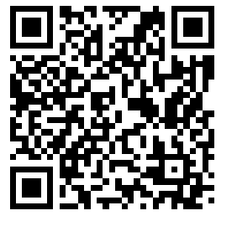
Think- Pair – Share Activity
Food Delivery Application
The complete application successfully allows users to register, select food, place orders, make payments, and track delivery. However, the restaurant owner says the application does not provide the daily sales report required in the project requirements.
Q1. Has the complete system been tested?
Q2. Can the customer accept the system?
Q3. Why?
THINK (2 min)
Identify:
One System Testing scenario.
One Acceptance Testing scenario.
PAIR (3 min)
Discuss your scenarios with a partner.
SHARE (5 min)

Slide 17
Example
System Testing Example
Test the complete flow from restaurant search → order placement → payment → delivery tracking.
Focus: Does the complete system work correctly?
Acceptance Testing Example
A customer representative verifies whether the application meets the agreed business requirement of ordering and tracking food conveniently.
Focus: Does the system meet user/business expectations?

Slide 18
Real-World Testing Flow
Individual Components
↓
Unit Testing
↓
Integration Testing
↓
System Testing
↓
Acceptance Testing
↓
Deployment
Testing perspective changes at every level:
Level | Focus
Unit | Individual component
Integration | Component interaction
System | Complete system
Acceptance | User/business approval

Slide 19
Key Takeaways
System Testing
Tests the complete integrated system against specified requirements.
Acceptance Testing
Determines whether the system satisfies user and business needs and is ready for acceptance.
Simple Memory Trick:
System Testing = "Does it work?"
Acceptance Testing = "Is it what the user wanted?"

Slide 20
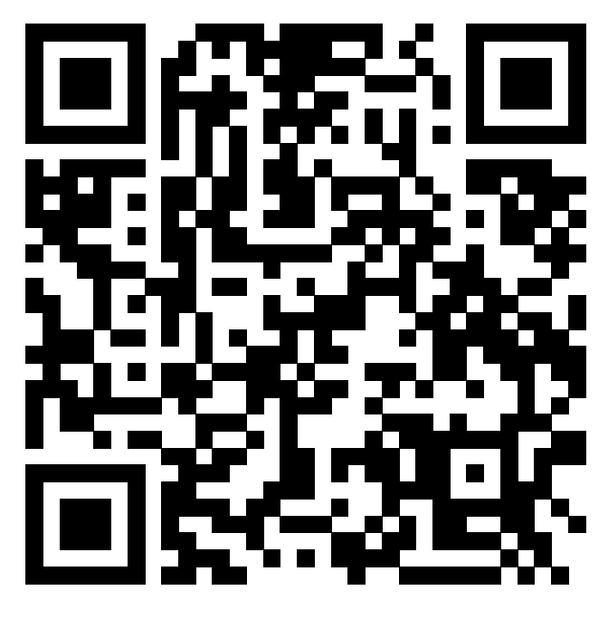
Quick Recap

Slide 21
Thank you
Next Topic- Defect Management

